Slide 1
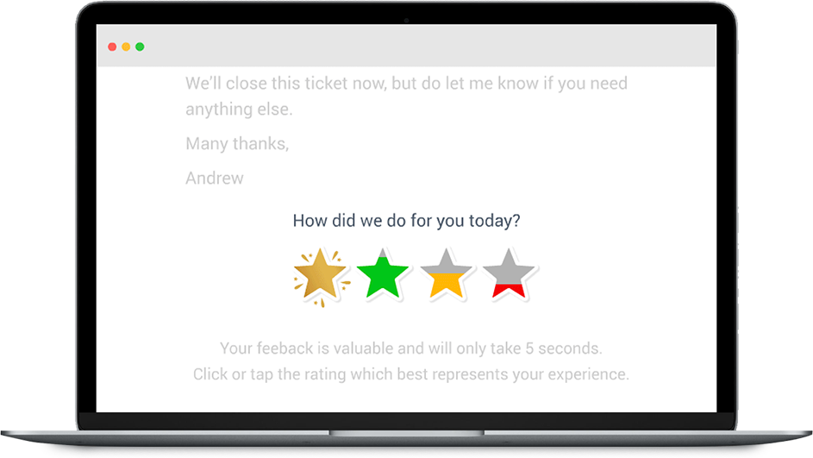

1-click email surveys customers love
The case for email customer feedback

Slide 2

What if you had an early warning system that would help you identify at risk customers?

Slide 3

And help you identify and reward your most customer-enchanting staff?

Slide 4

What if your surveys weren’t a source of customer boredom but of customer joy?

Slide 5
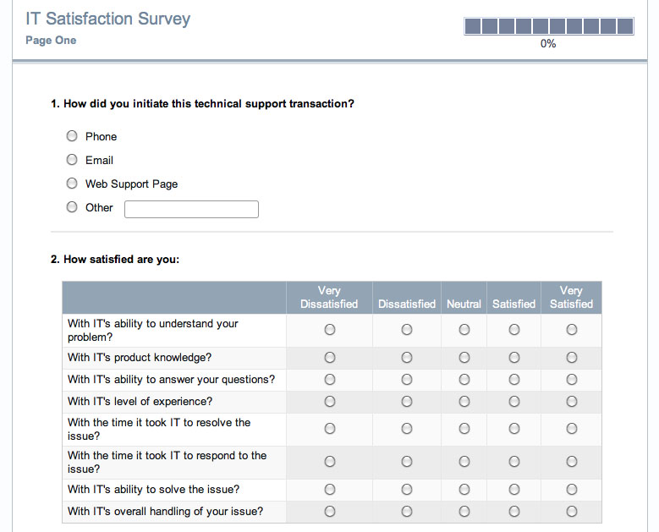
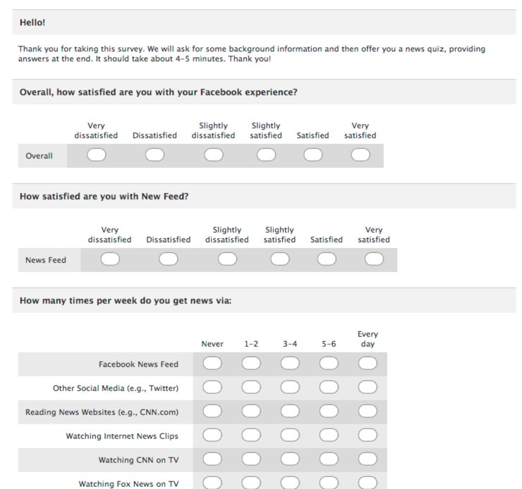
Are your surveys struggling? Go from this…

Slide 6
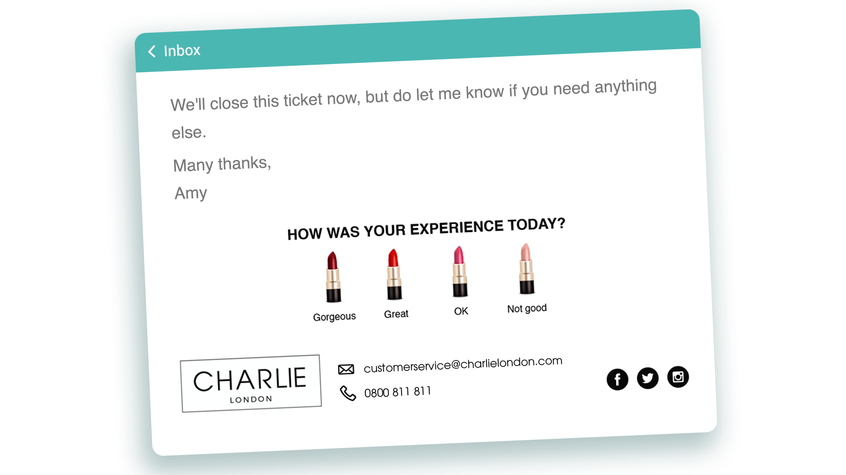
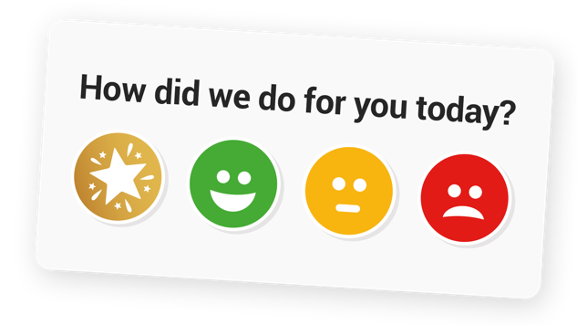
To this

Slide 7


What if you could stop even 5% of customers leaving you
And increase your employees’ performance by 5%
And increase your survey response by up to 600%
What’s that worth to your business?
This is what we do

Slide 8

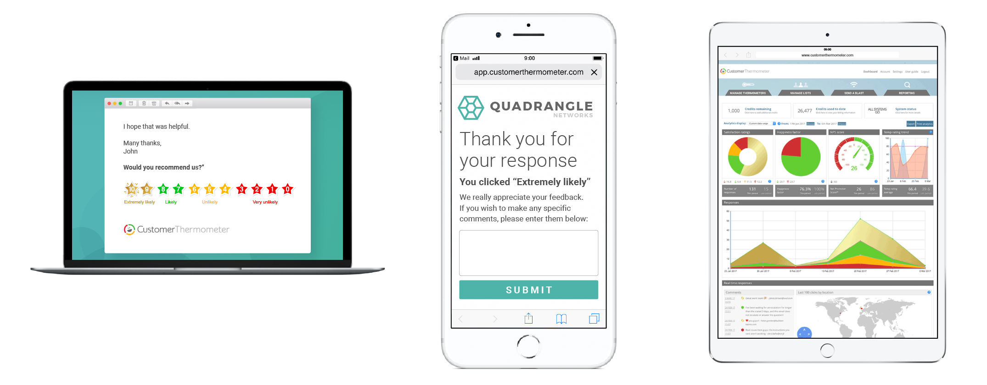
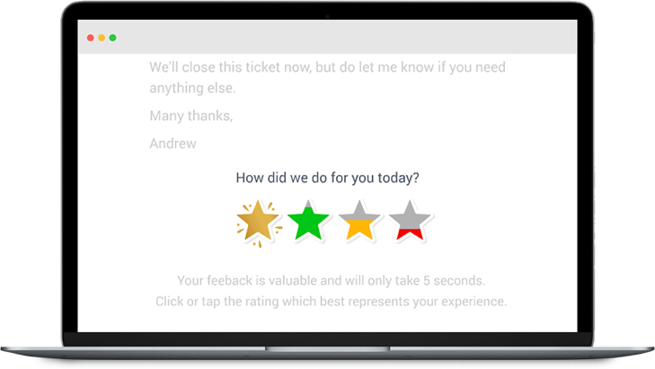

Slide 9
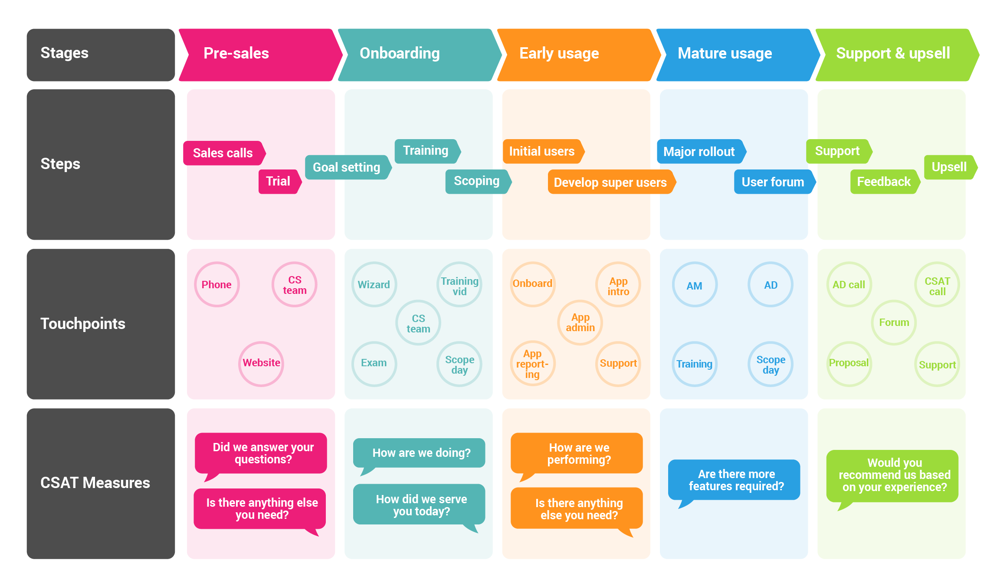
Light touch
Use throughout the customer journey…

Slide 10
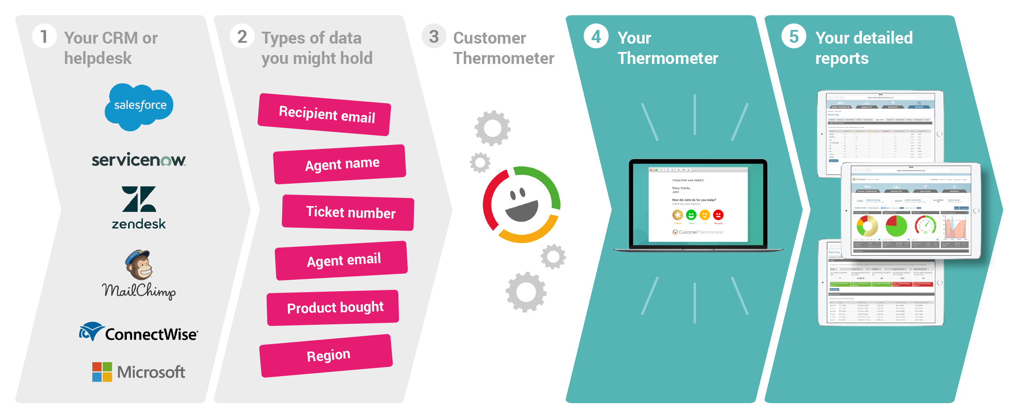

Use Customer Thermometer in combination with hundreds of other apps and software
www.customerthermometer.com/integration/

Slide 11
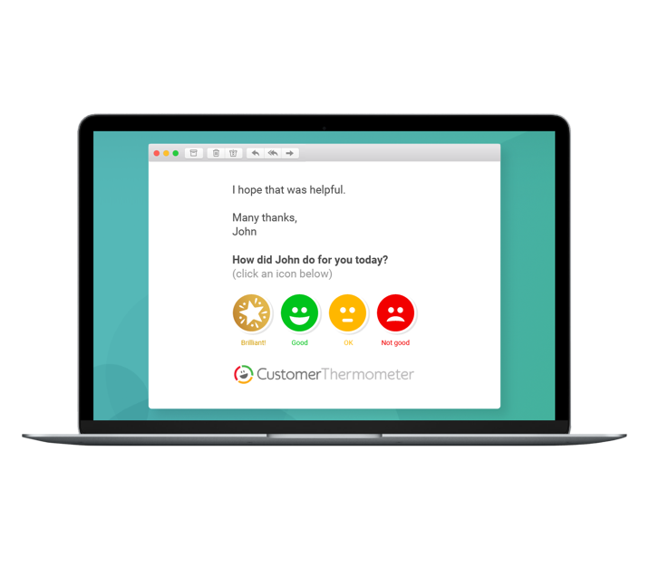

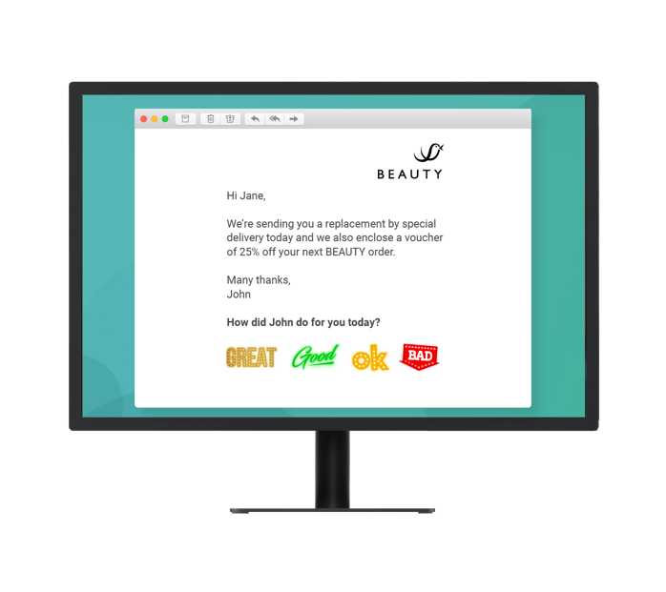
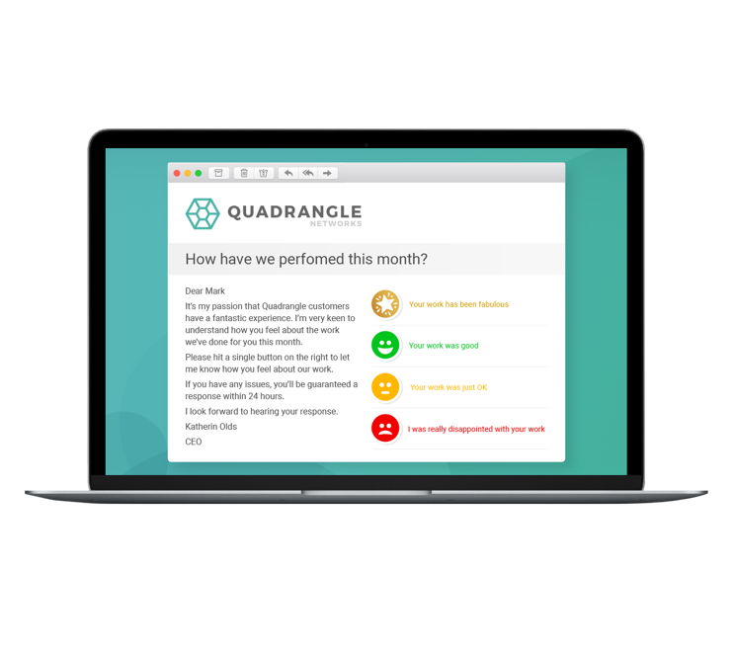
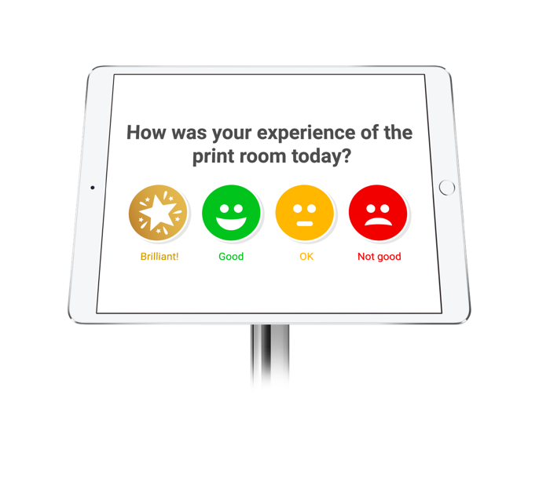
Four ways to get closer to your customers and staff
1
2
3
4
Notes:
1. Add Thermometers to your email signatures by inserting our buttons and attaching your unique links. Whether you use Outlook or Gmail signatures, our feedback buttons can give you continuous insight into how your customers are feeling.
2. Automatically append thermometers to emails sent by your CRM, ticketing, helpdesk, HR or other system. Works beautifully with Salesforce, ServiceNow, Kaseya, ConnectWise, Autotask, and hundreds more.
3. Send branded 1-click surveys from our own syste, Using this approach you can upload a CSV or your contacts and send a survey out in a single blast. Similar to MailChimp. This can be sent via API and webhooks, so can be triggered by other systems in your business. The template is already available inside Customer Thermometer and can be sent in minutes. No coding or development required. Customize your email template, then upload your recipients, alongside any associated data, such as Account manager, customer type etc. We then send your 1-click emails and collect your results.
4. Use our iOS app

Slide 12
…the click is just the beginning
A ‘gateway’ survey which captures maximum initial feedback and can route customers on sats-based journeys, and trigger closed-loop processes
A pulse-checker with enormous power to improve customer satisfaction
Integrations with all leading EFM, CRM, helpdesk, survey and workflow systems
A full API & webhooks so that all sats data can be pushed back into those systems
Maintaining our simplicity for the end-user, as well as our closed-loop focus, and “alert/action” nature

Slide 13
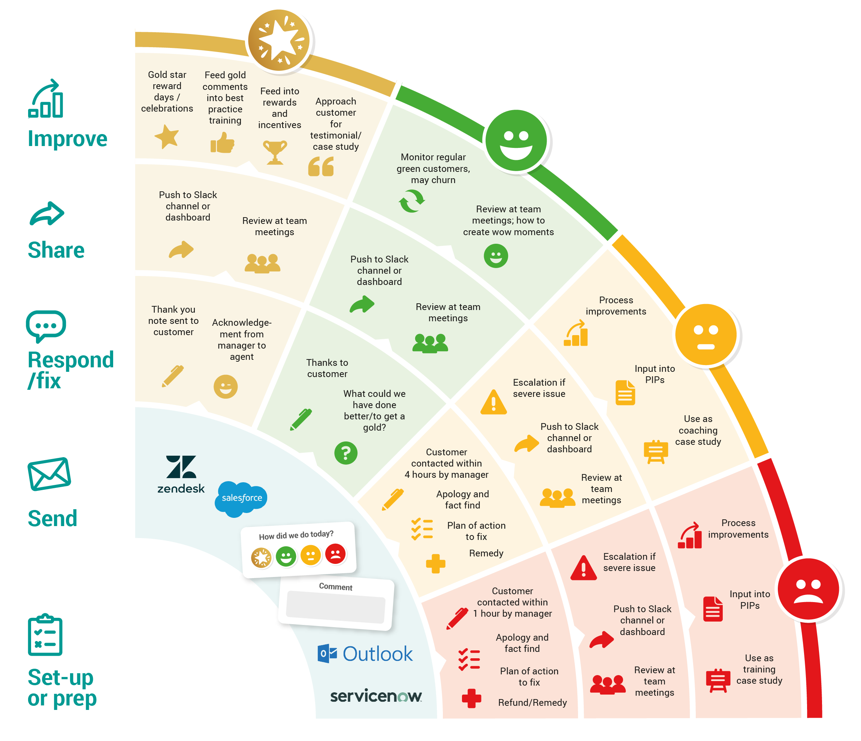
A gateway to driving CSAT across the business
Notes:
Customer Thermometer gathers max response
-emails
-embedded
-Outlook
-tablet
-in-account
It’s how you drive and use the feedback across your business that counts.
Negative responses: drive Alerts, service recovery communications, action & further survey/info gathering, staff training
Positive responses: Alerts, feedback thanks, staff reward, social media further survey/info gathering, staff training
EFM/CRM/helpdesk writeback for sales & service intel. Per contact/per account sats reports
The idea here is to be constantly driving responses towards the positive. Continuous improvement.

Slide 14
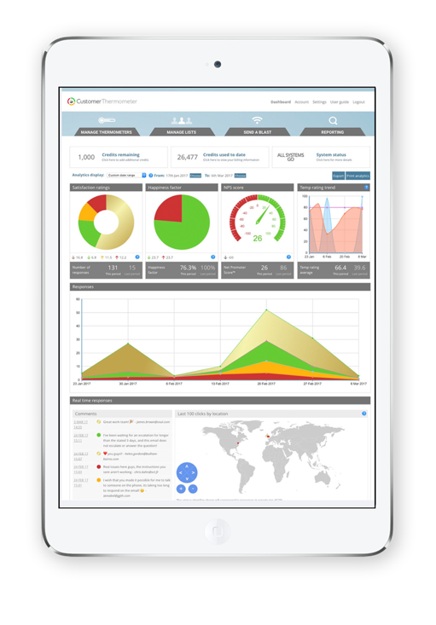
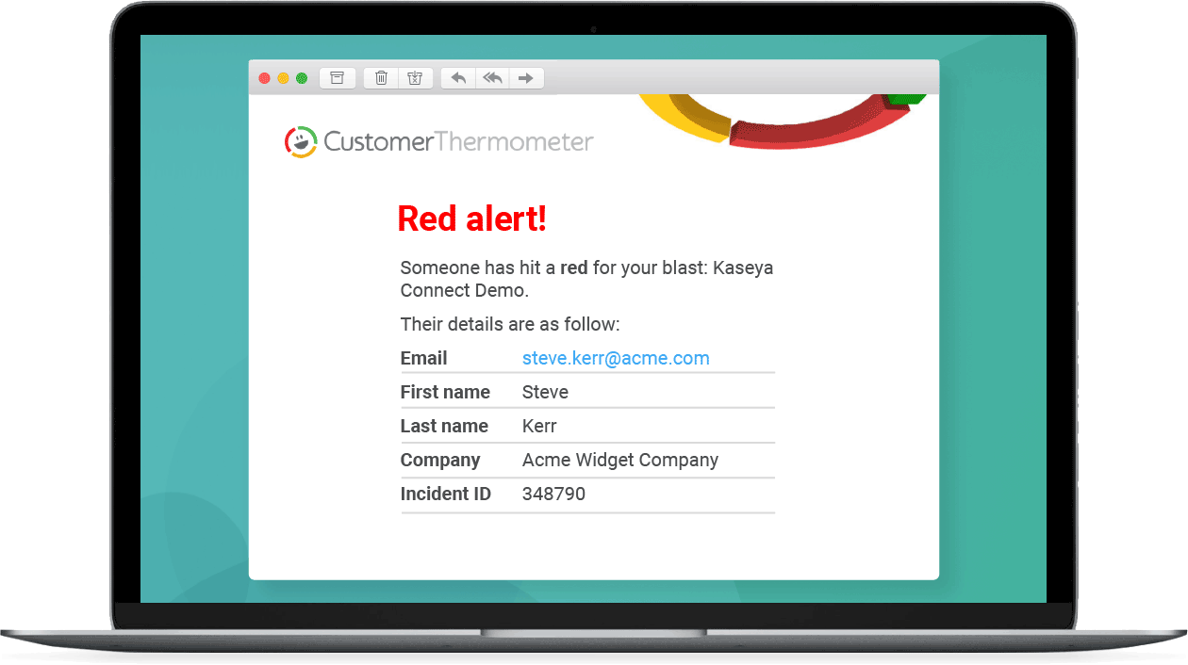
…all lead back to a powerful analytics & alert platform that tracks real customer feedback, in real time
Know exactly who is happy and who is not
Be alerted in real-time to issues
Minute by minute feedback
by response type and geography
Comment cloud, league tables,
Individual CSAT and more.
Use our webhooks and API to drive real action across myriad other systems and processes
Push feedback into Slack, Teams, Asana and more
Notes:
4 modes of operation all feed back into central real-time reporting & analytics: temp rating, comparison reports, built-in NPS measure, league tables and 6 other reporting types
Context-sensitive landing pages, alerts and iPhone/Android notifications
Self-service with powerful real-time analytics including geolocation, comment cloud, sort by rating etc
You can also view and share reporting data using our secure API, without needing to log into your account. API using either the REST or SOAP method. Create buttons or triggers within your 3rd party cloud accounts (such as Salesforce.com or Zendesk.com) to send an Email Thermometer survey directly to a customer contact record.
Customer Thermometer webhooks can provide other applications with real-time information. They deliver data to other applications as it happens, meaning you get data immediately.
Webhooks are a useful tool for executing an action in another app or system after a specific response event happens – for example. when a customer hits a gold star, or leaves a comment on a red response.
They can be used as alerts to keep your systems and partner applications in sync with response events that occur within Customer Thermometer.
Customer Thermometer can send webhooks to any publicly accessible server. When an event in Customer Thermometer triggers a webhook (e.g., a red response is received), Customer Thermometer will attempt to send this notification to the endpoint(s) you specify. You can specify an unlimited number of endpoints for any combination of Thermometers.

Slide 15
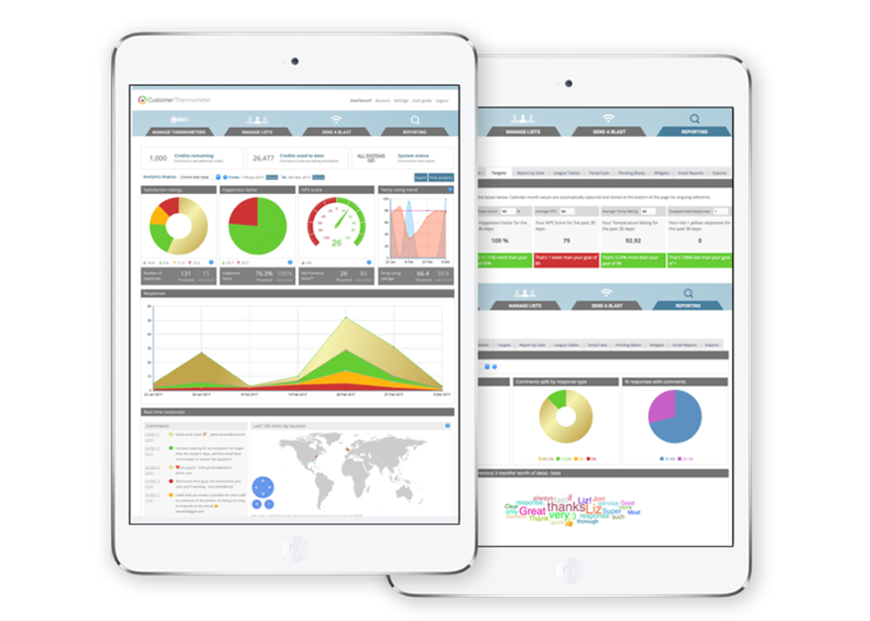
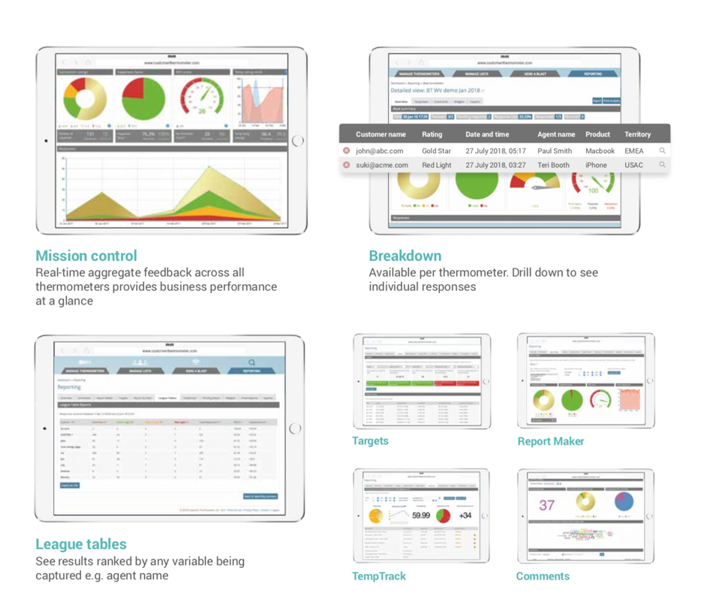
A wide range of out of the box reports
Notes:
Out of the box reports include:
Mission control: at-a-glance overview of complete performance with a NPS option, real-time comments feed and world map showing feedback location
Survey breakdown: individual view of feedback, ratings, comments, all trackable to individuals, on a survey-by-survey basis. See exactly who is happy and who is not.
League tables: see your customer feedback ranked by agent, product, territory, service type, anything!
Targets: set targets for CSAT, NPS, number of ratings, and immediately see if you are hitting them or not
Report maker: create your own report for any combination of survey(s)
TempTrack: see the history of feedback from any single customer over time, simply by entering your email address
Comments: see how many verbatims you have received
Widgets: get graph and pie chart widgets of your feedback for you to embed in BI/MI dashboards,
Exports: as you’d expect there are a full set of exports available

Slide 16
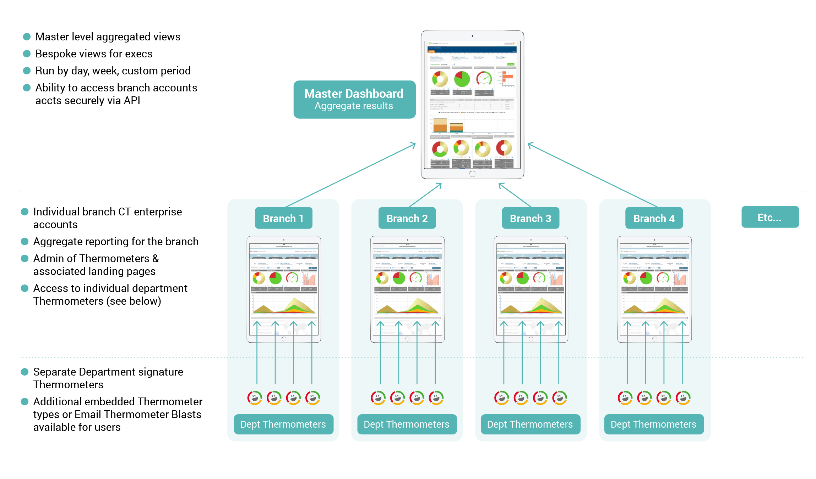
With additional flexible access & reporting options for Enterprises

Slide 17
Why Customer Thermometer
Immediately actionable insight
  Know exactly who is unhappy, in real time
Reduces the email your customers get
  No separate email requesting feedback is sent. Customer Thermometer can appear at any point in the ticket/case/thread process, not just the end
Engages customers visually
  Customize your rating buttons, create your own question, use your company’s tone of voice
Gives you a better response rate
  Users quoted as seeing a dramatic increase in customer feedback
Allows you to pinpoint areas of dissatisfaction
  See satisfaction by agent, territory, product, time, date, position in the buying cycle and much more
Our famous Red Alert system
  Never lose another customer. Be alerted in instantly to unhappy customers

Slide 18


Join the world’s most customer-obsessed brands

Slide 19

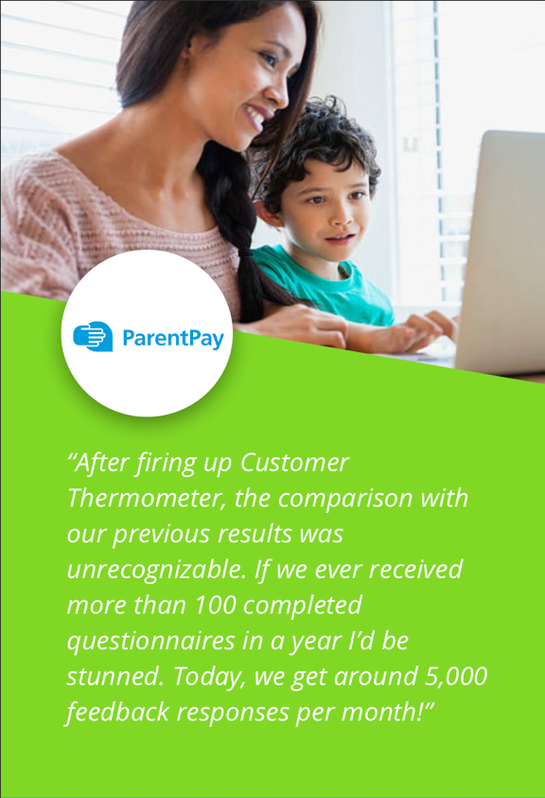

We get you more… more feedback and a more representative view

Slide 20



Simple and effective
The benefits of using Customer Thermometer
Speed
Actionable Intelligence
Cost-effective
Simple to use
(in just one click…)
Quick to deploy (sometimes in minutes)
Larger response rates (many times more than other solutions)
More responsive
(to customers and staff)
Deeper insight
(with dashboard analytics)
Flexible pricing
(saleable to organization size and need)
Easy to integrate (embeds with all leading helpdesk and CRM tools, such as ConnectWise, MailChimp, and Salesdesk)

Slide 21
Today successful companies start with the customer…
And the more information you can learn about the customer, the better you can serve their needs, and the more valuable the relationship becomes.
-Tien Tzou

